Slide 1
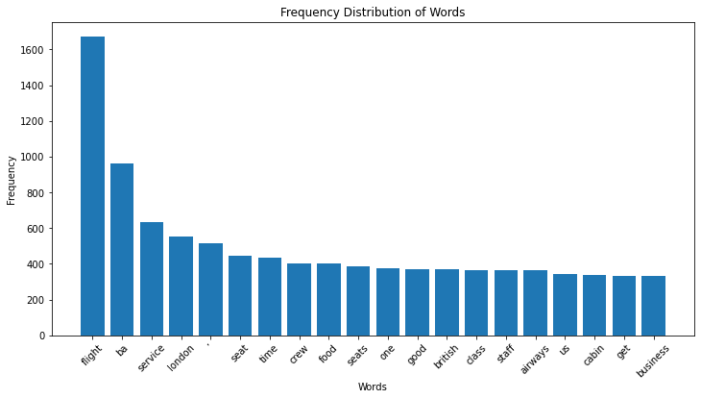


BRITISH AIRWAYS REVIEWS ANALYSIS
From the reviews analysis, there are:
509 positive reviews
371 negative reviews
20 neutral reviews
Some of the mostly common words used in the reviews are Flight,
Seat, time, food,service and good indicating that most of the
Reviews are generally positive.
Further analysis can be done to investigate more on the customer
needs based on the reviews.

